Slide 1

Circular Pie
Team 5 Project Manager: Yash Kantharia
Team Members: Poonam Adtani, Alan Parmar, Sarvesh Desai, Maneesha Narahari, Saichand reddy, Tharun reddy

Slide 2
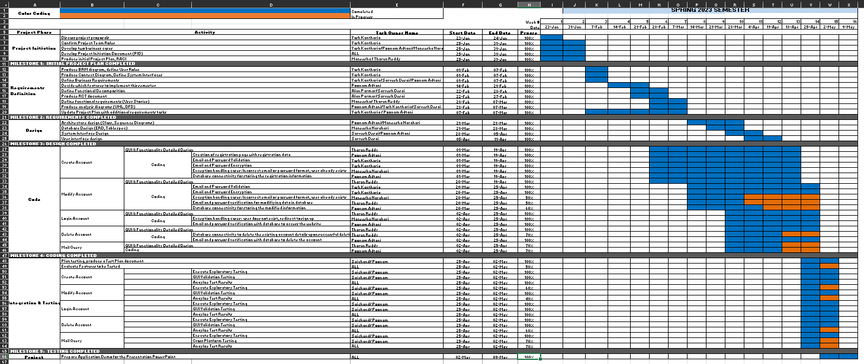
1. Project Plan

Slide 3
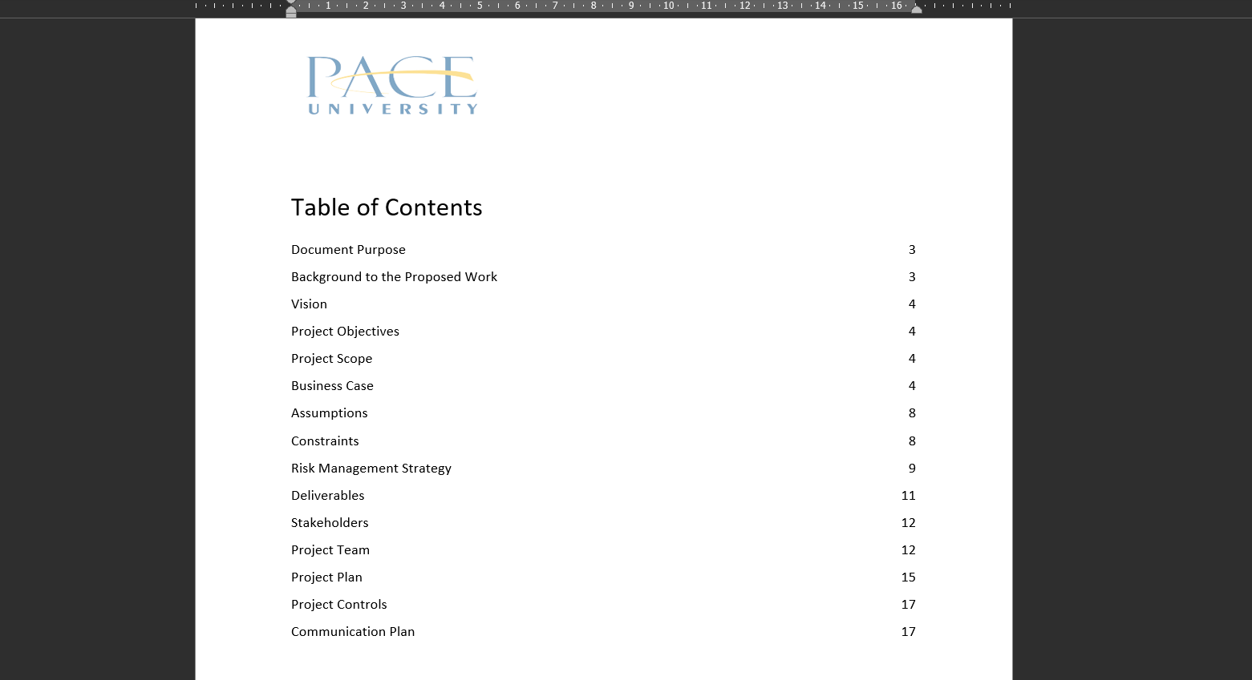
2. PID Document

Slide 4
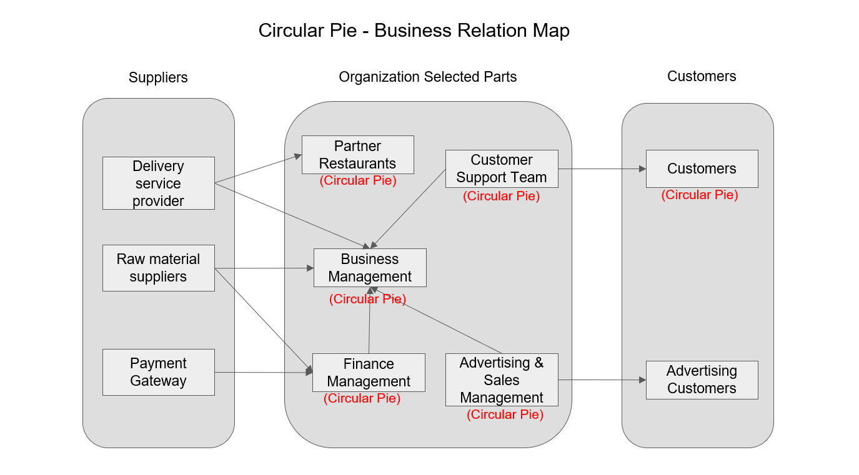
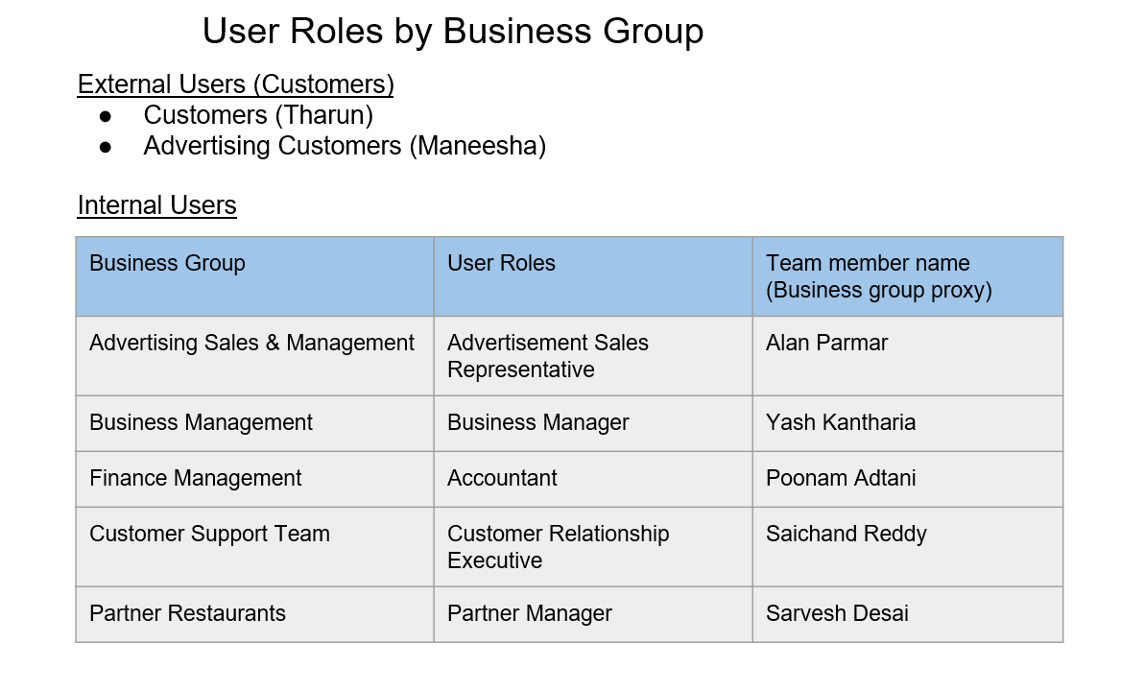
3. BRM Diagram - User Roles – Maneesha Narahari

Slide 5
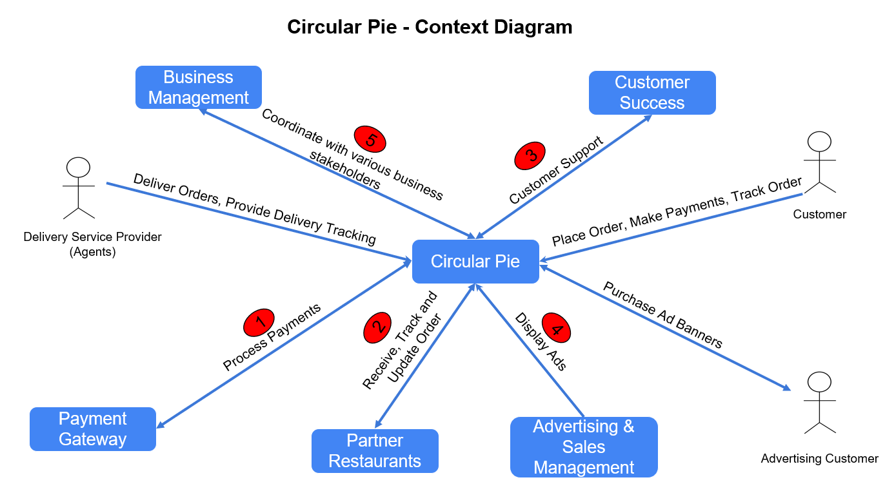
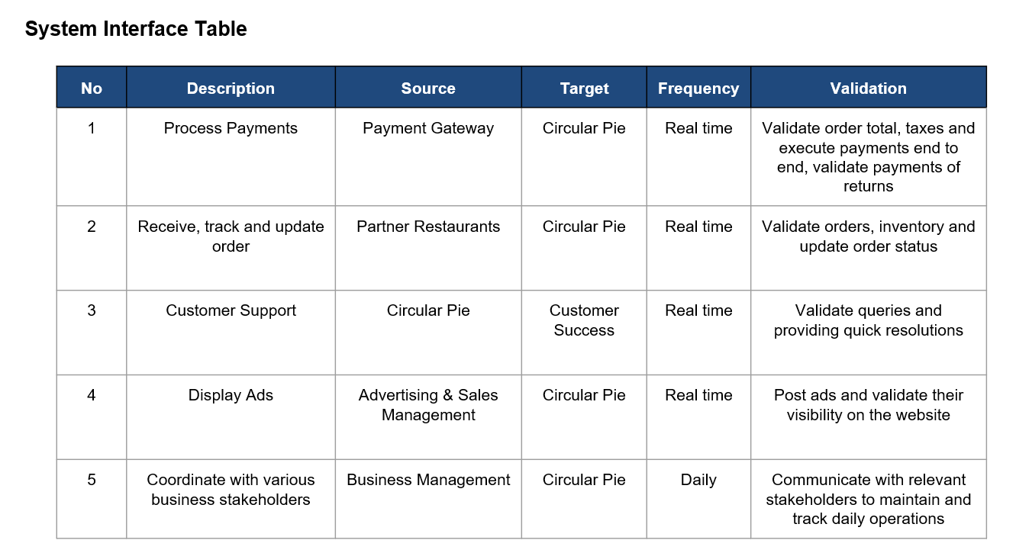
4. Context Diagram - System Interface Table - Maneesha Narahari

Slide 6
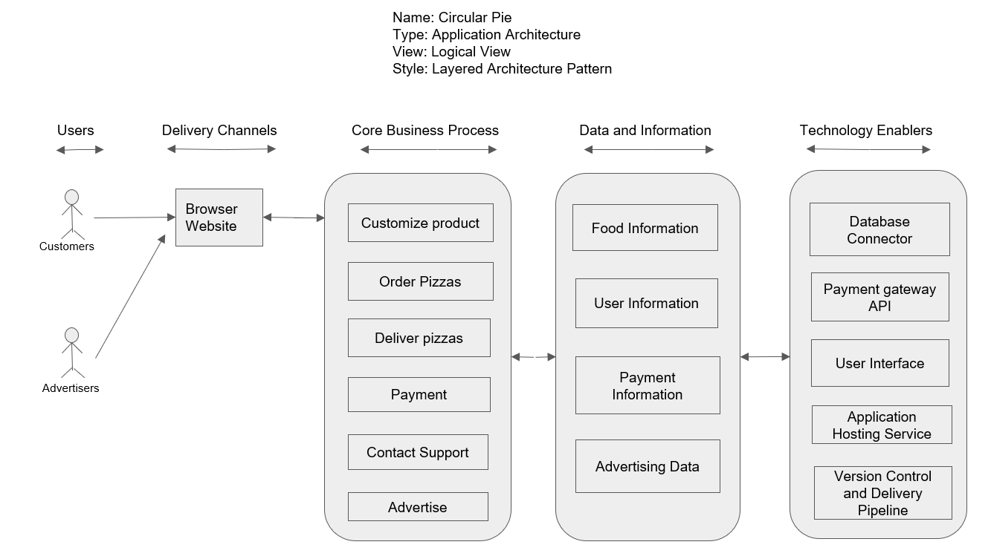
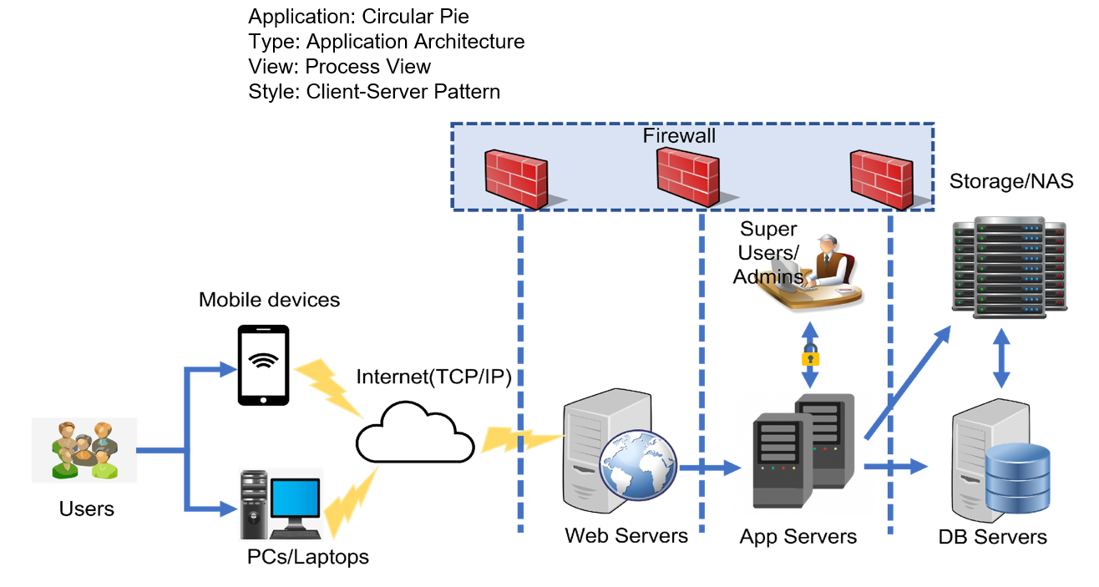
5. Architecture Diagram - (Logical & Process views) – Tharun reddy

Slide 7
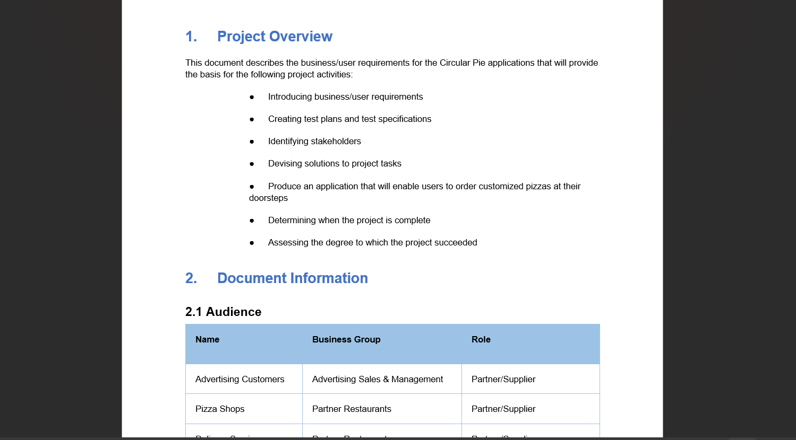
6. Business Requirements - Tharun reddy

Slide 8
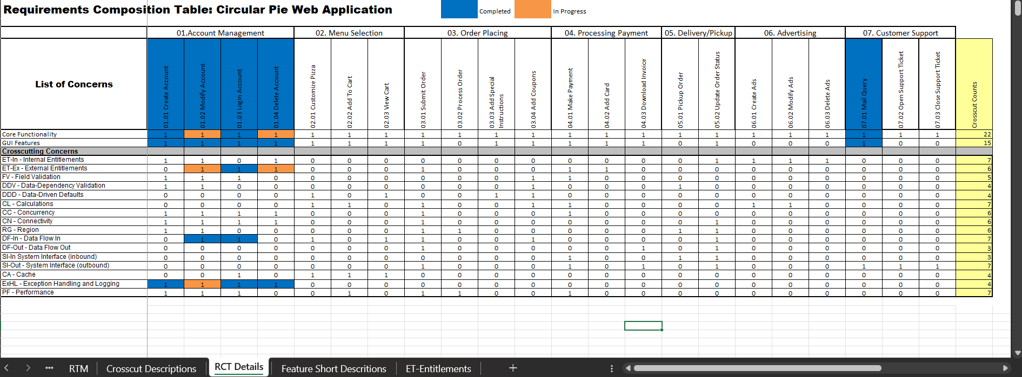
7. RCT – Poonam Adtani

Slide 9
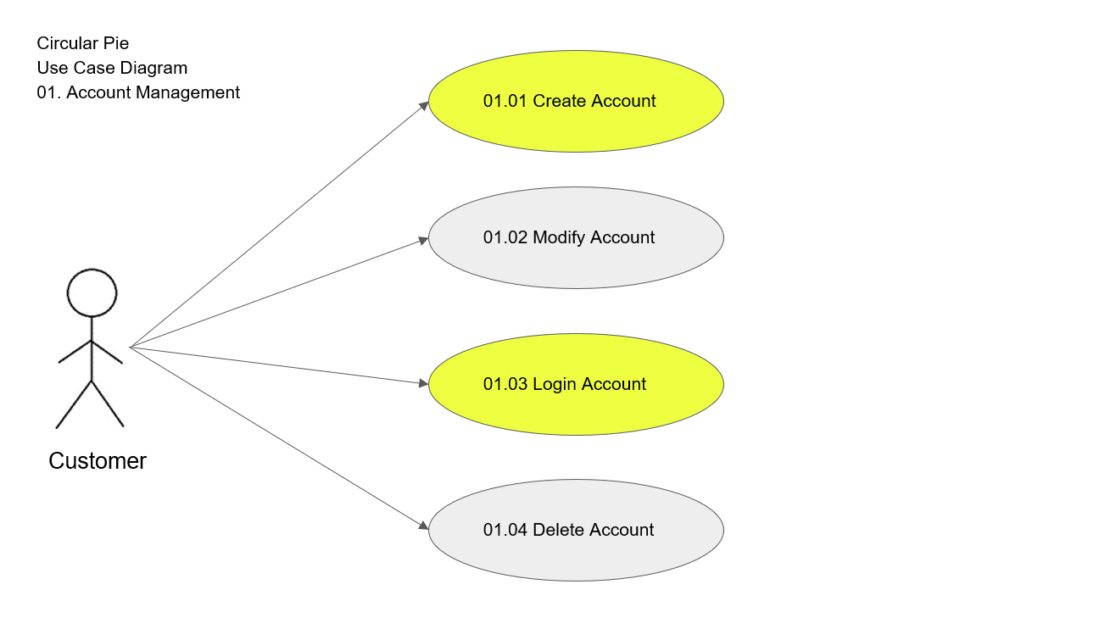
8. Use Case Diagrams - (UML) – Poonam Adtani

Slide 10
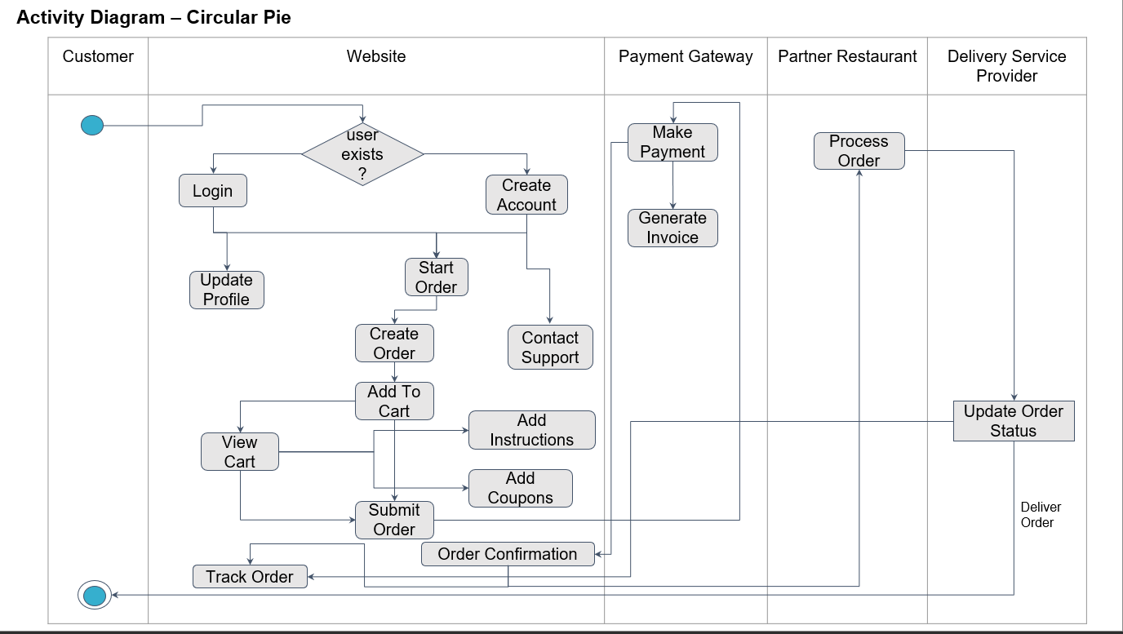
9. Activity Diagram - (UML) – Poonam Adtani

Slide 11
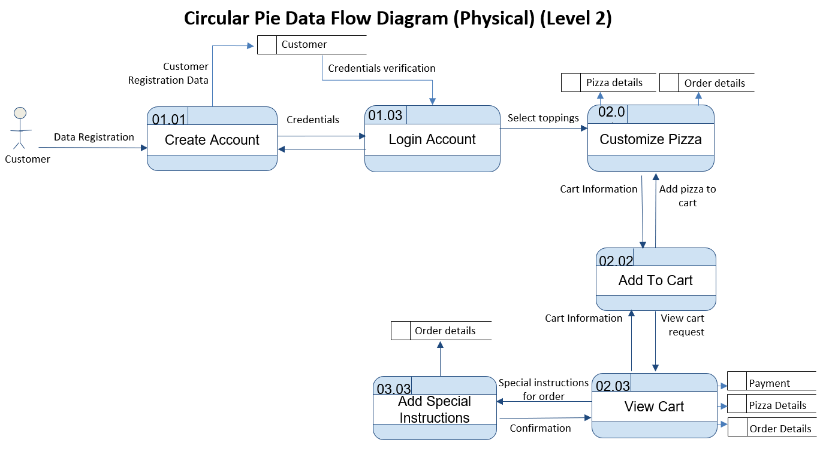
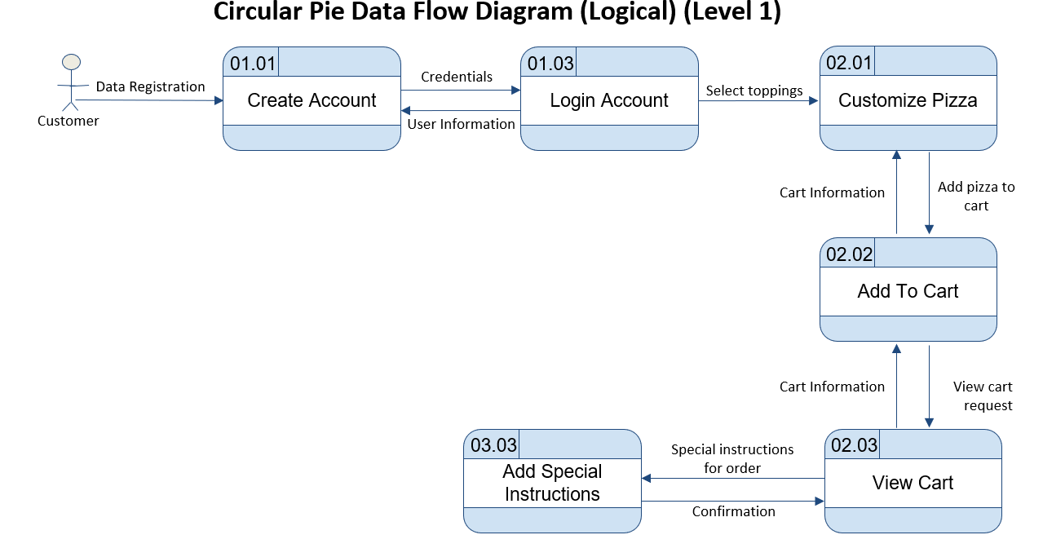
10. Data Flow Diagrams - (Logical, Physical) - Alan Parmar

Slide 12
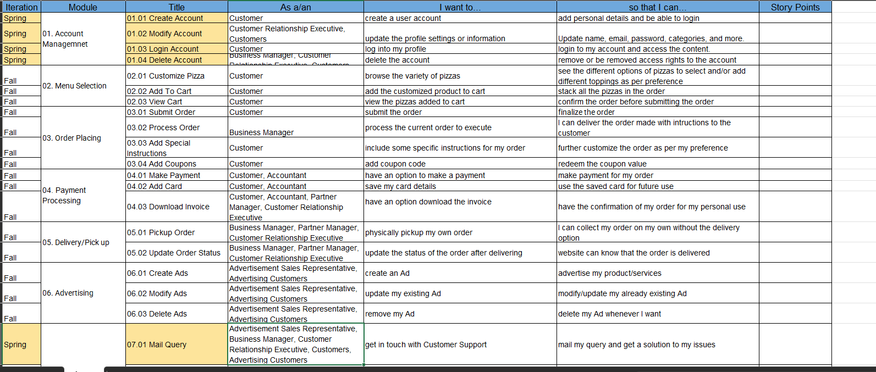
11. Functional Requirements - (User Stories) - Alan Parmar

Slide 13
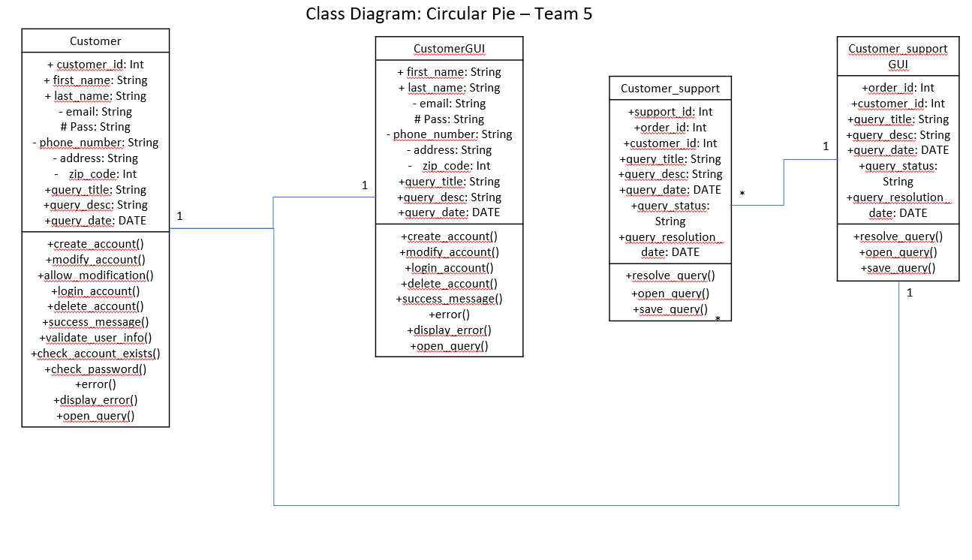
12. Class – Diagram – Sarvesh Desai

Slide 14
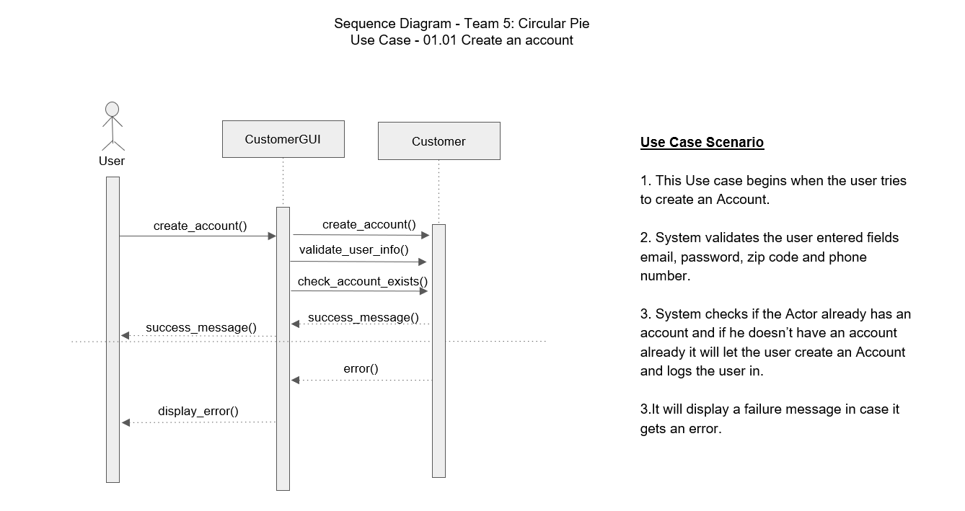
13. Sequence – Diagrams – Sarvesh Desai

Slide 15
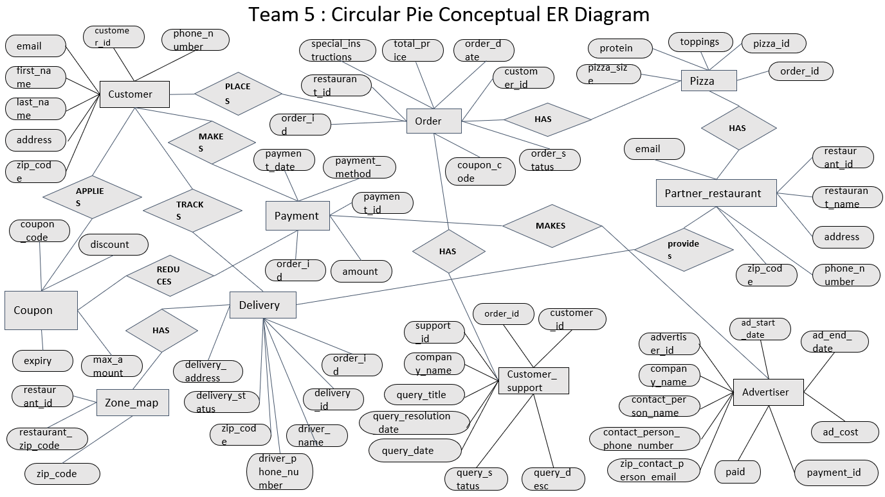
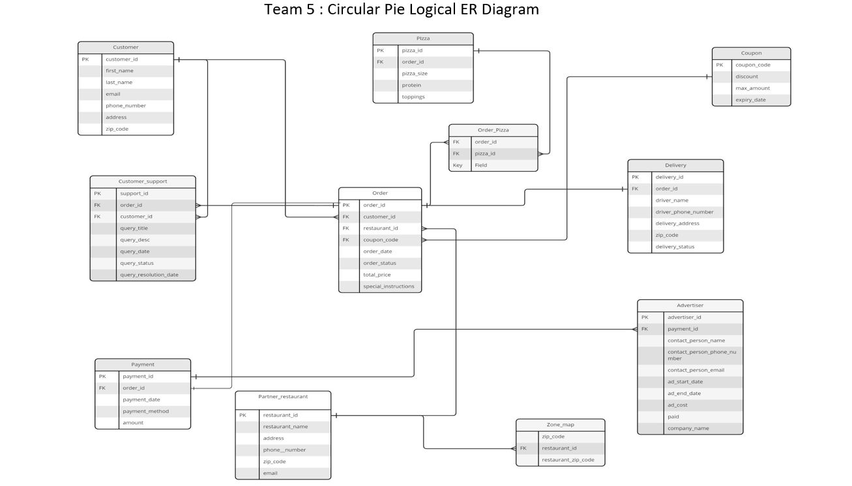
14. ER-Diagrams - (Conceptual, Logical) – yash kantharia

Slide 16
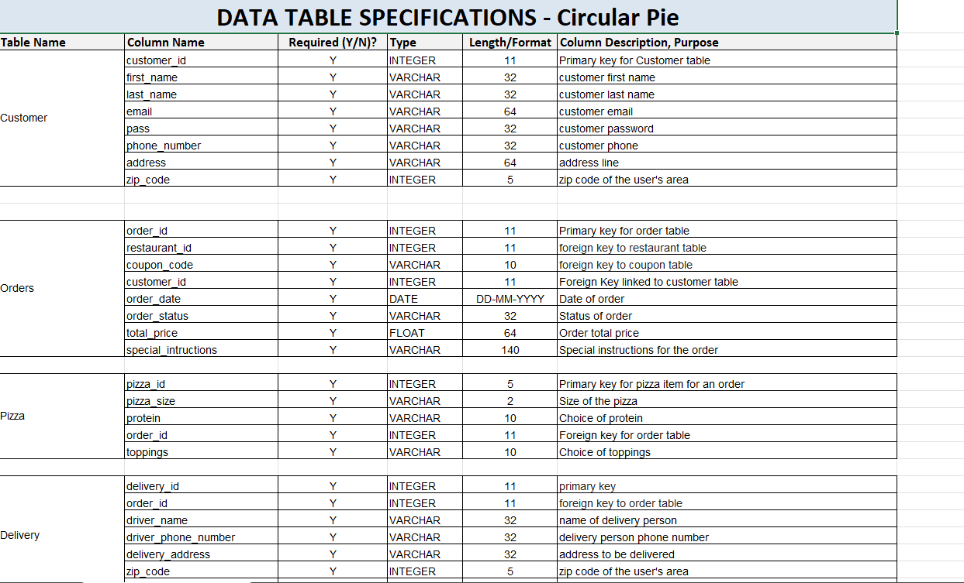
15. Table Specifications (Data - Dictionary) - yash kantharia

Slide 17
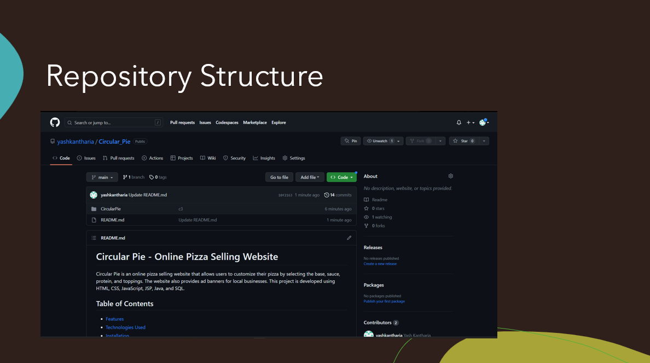
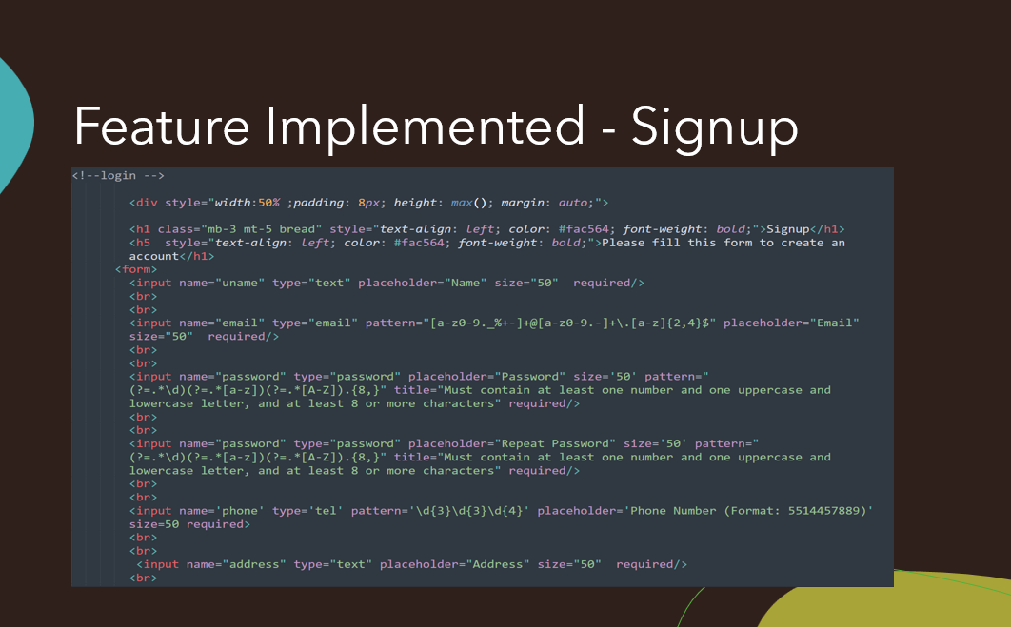
16. Github Repository – yash kantharia

Slide 18
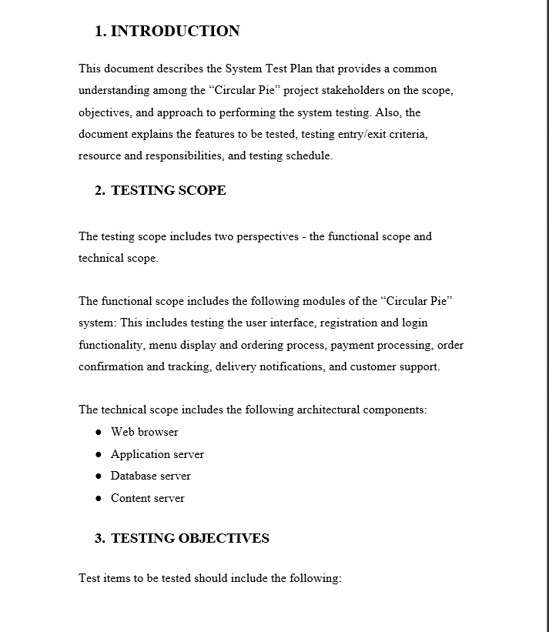
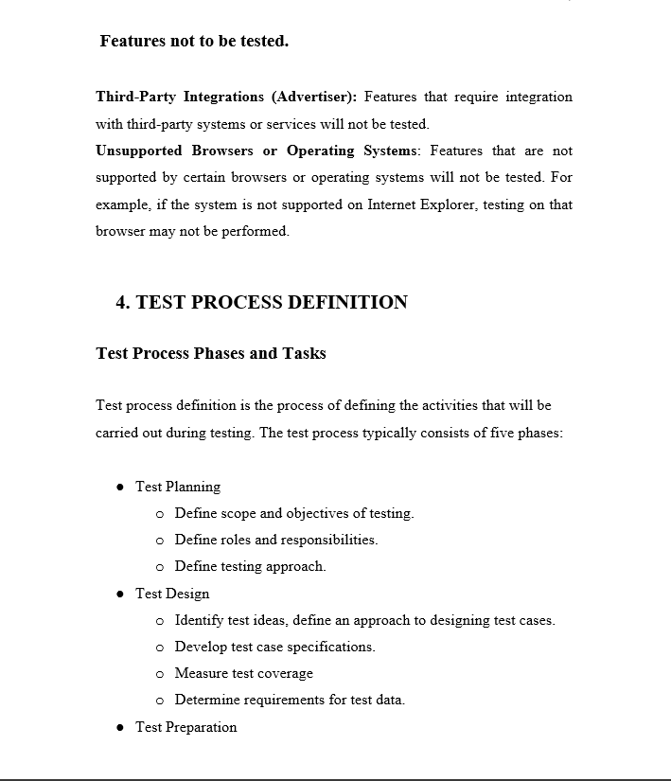
17. Test Plan – Document – Saichand reddy

Slide 19
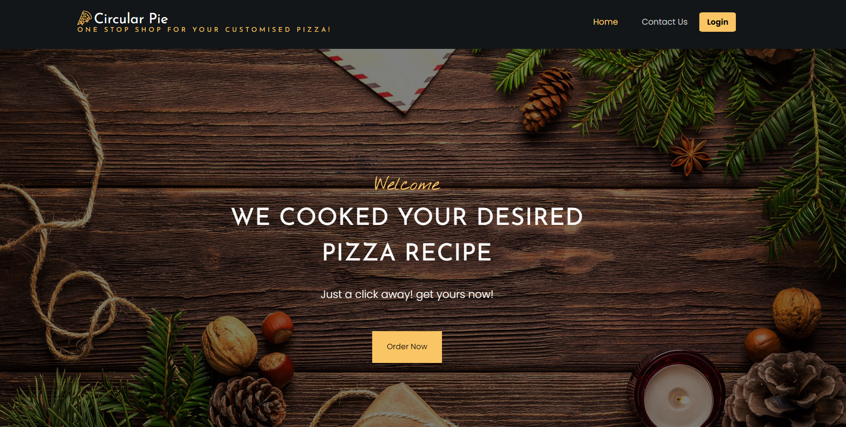
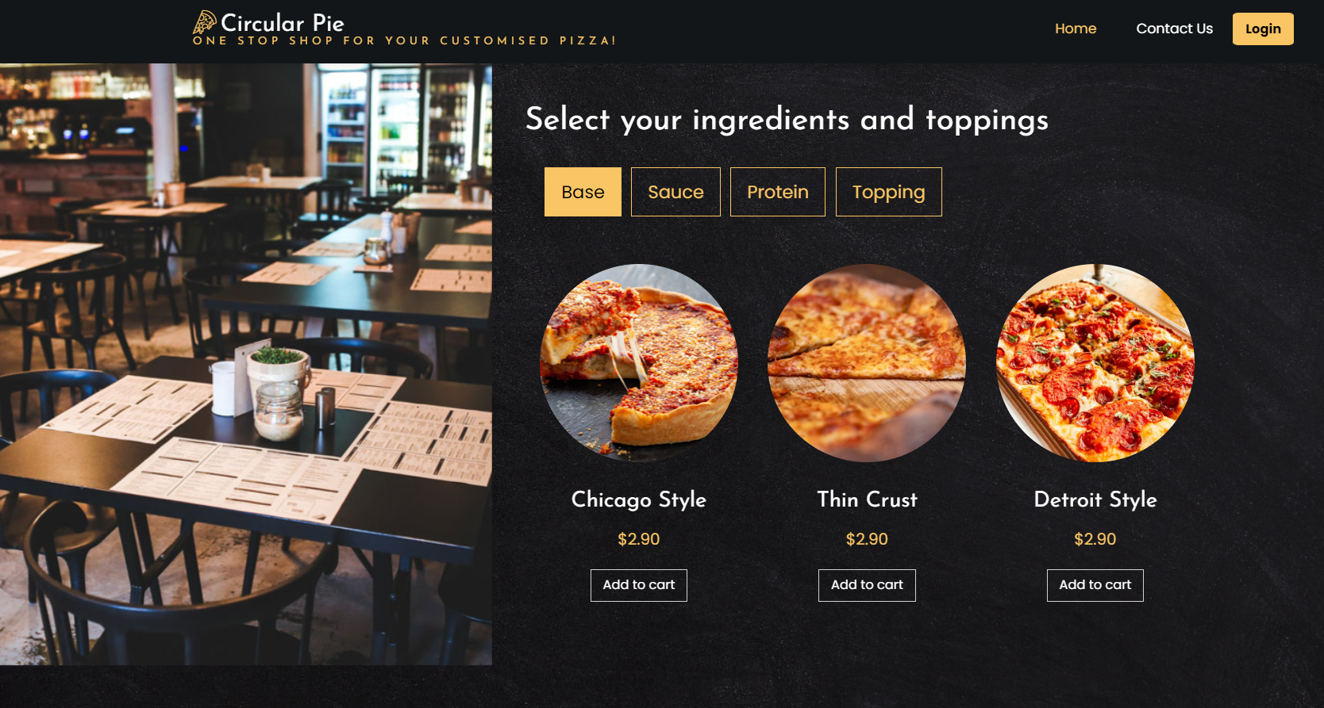
18. Application Demo – Poonam Adtani

